Slide 1



Workshop on
“Systems Biology: Where Biology Meets Computing”
Faculty coordinator:
Dr. Asha Vijayan
Assistant Professor (Sl. Gr)
Mind Brain Center
Amrita Vishwa Vidyapeetham
mindbrain@amrita.edu
23-05-2025

Slide 2
Schedule
Time | Session | Faculty In Charge
9.00-9.45 am | Decoding Life: Systems Biology at the Intersection of Biology and Computing" | Dr. Asha Vijayan
9.45-10.30 am | CellDesigner in Action: A Workshop on Systems Biology Modeling | Dr. Arathi G.R
Tea Break
10.45-11.00 am | From Memory to Movement: Exploring Common Grounds in AD and PD | Ms. Sowmiyakrishna G
11.00-11.20 am | Hands on Session: Identifying molecules and other factors from Research Articles | Dr. Asha ,Dr. Arathi and Ms. Sowmiyakrishna G
11.20-1.00 pm | Hands on Session: Finding more articles to complete the pathway
Lunch
1.45-2.30 pm | Hands on Session: Modelling the pathway | Dr. Asha ,Dr. Arathi and Ms. Sowmiyakrishna G
2.30-3.30 pm | Hands on Session: Simulate and Analyse the pathways
3.30-4.00 pm | Hands on Session: Discussion on the findings

Slide 3
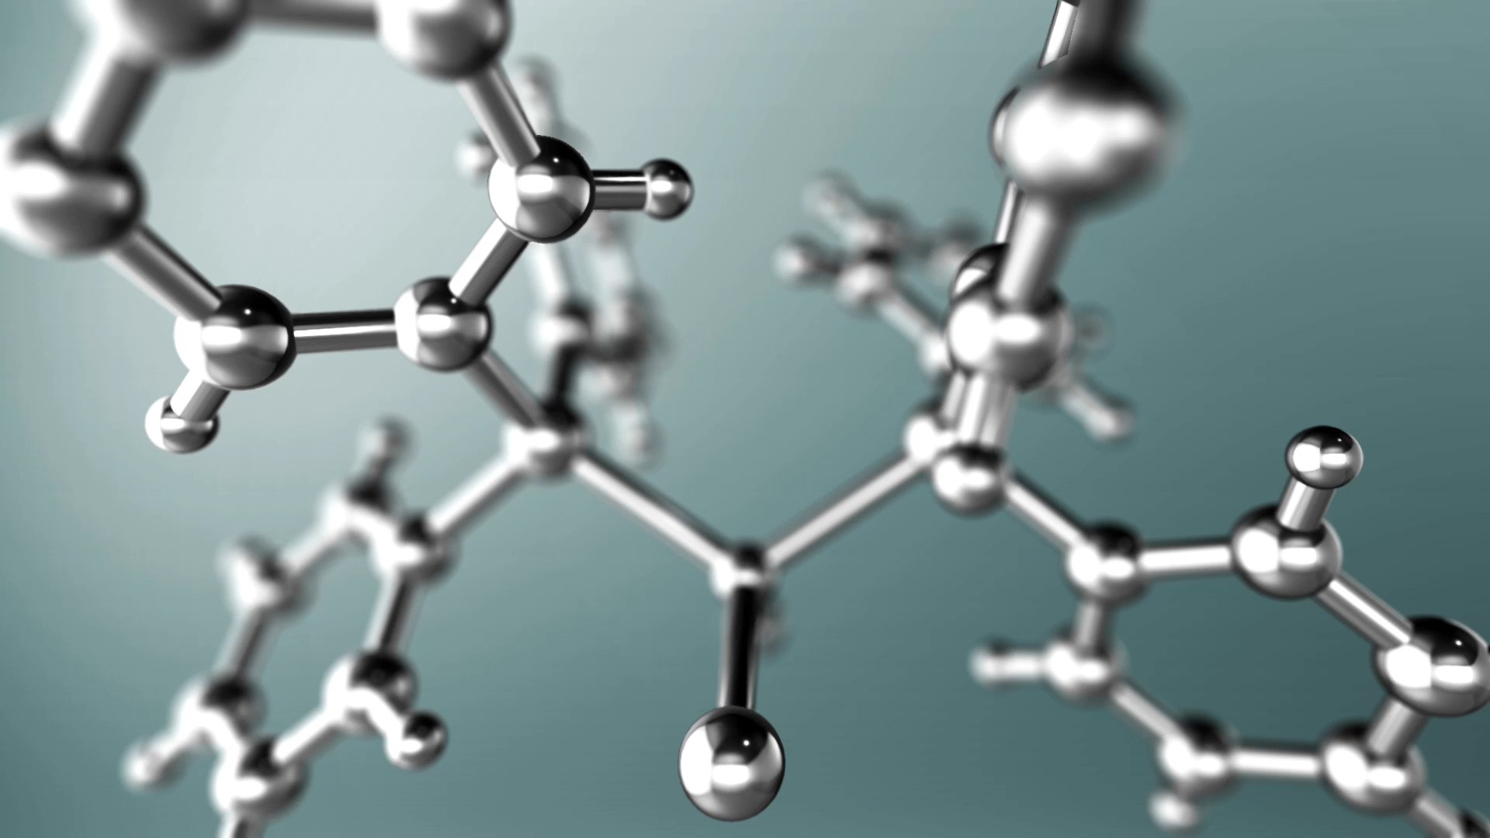
Decoding Life: Systems Biology at the Intersection of Biology and Computing
Dr. Asha Vijayan

Slide 4
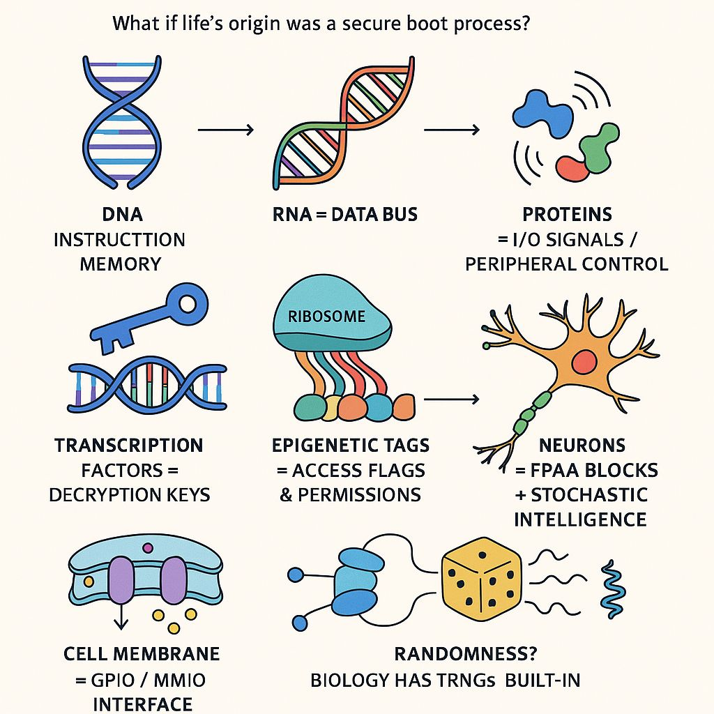
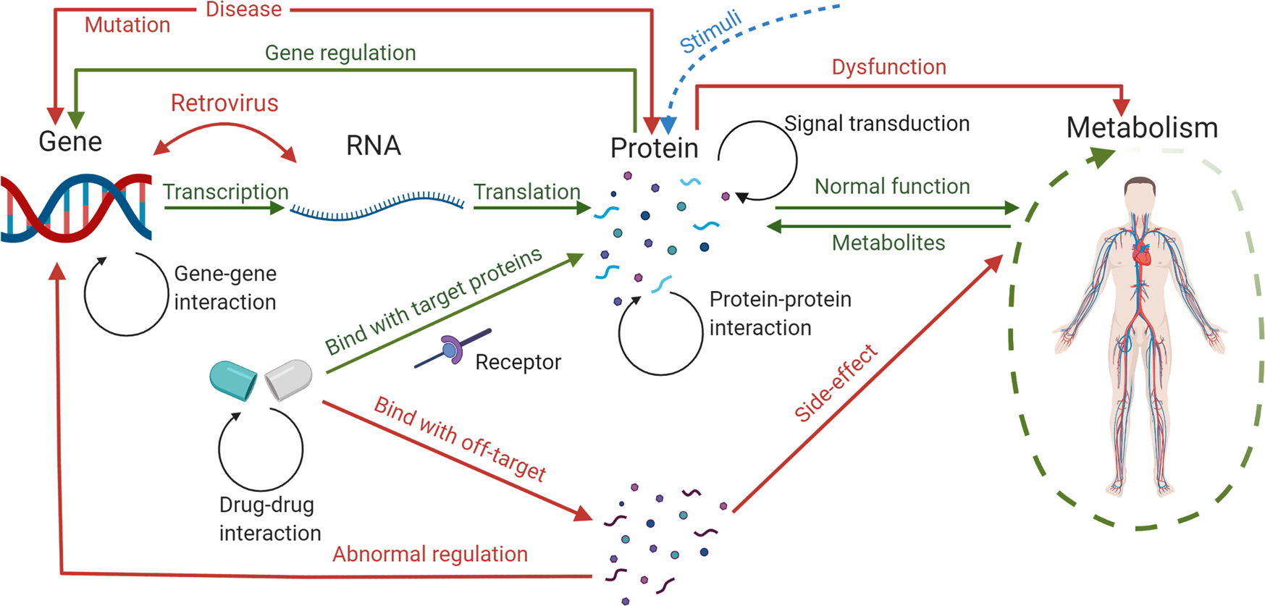
Decoding systems
Yue, R., Dutta, A. Computational systems biology in disease modeling and control, review and perspectives. npj Syst Biol Appl 8, 37 (2022). https://doi.org/10.1038/s41540-022-00247-4

Slide 5
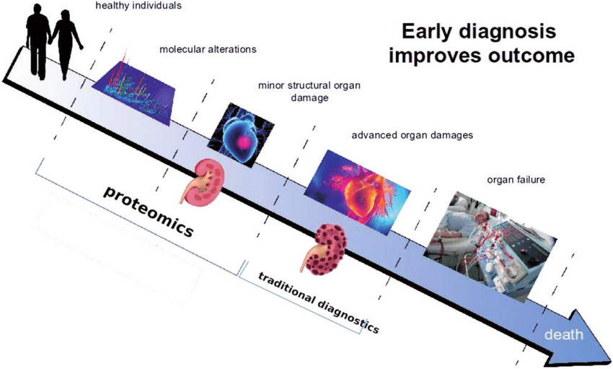
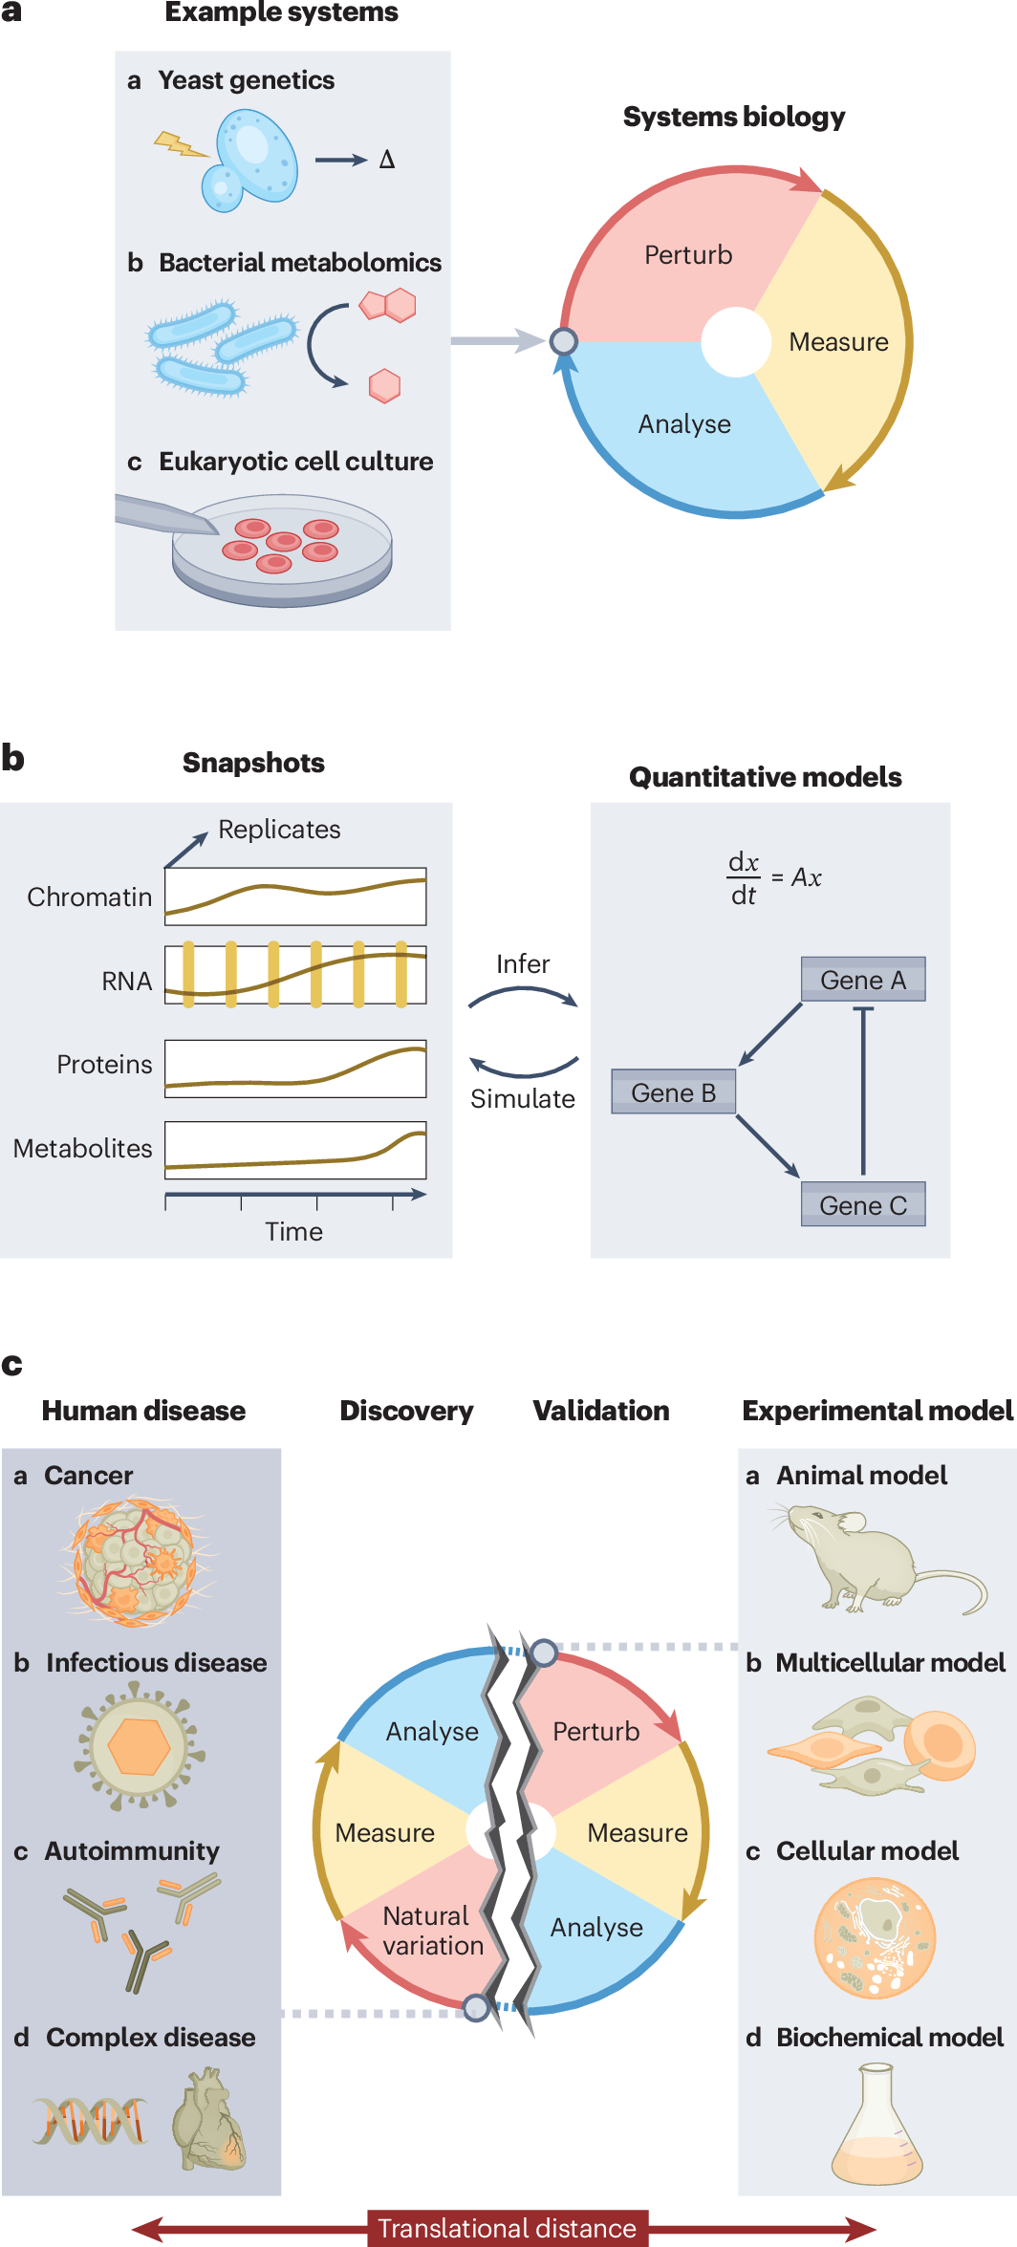
Why Systems Biology ?
Early diagnosis of diseases
Drugs without side effects
Tracing of drug treatments
Improved Healthcare
Reliable diagnosis
Targeted therapeutic
treatment
Fischer, D.S., Villanueva, M.A., Winter, P.S. et al. Adapting systems biology to address the complexity of human disease in the single-cell era. Nat Rev Genet (2025). https://doi.org/10.1038/s41576-025-00821-6

Slide 6
What is Systems Biology
Aiming at system level understanding of biological systems
Various sources to understand the system
Complexity
Genotype
RNA
Protein
Metabolite
DNA
Flux
Phenotype
Transcriptomics
Proteomics
Metabolomics
Fluxomics
Genomics
Epigenomics
Omics
Genetic variants
Epigenetic modifications
Gene expression
Protein- Protein interaction
Metabolic pathways
Flux Distributions
Diseases

Slide 7
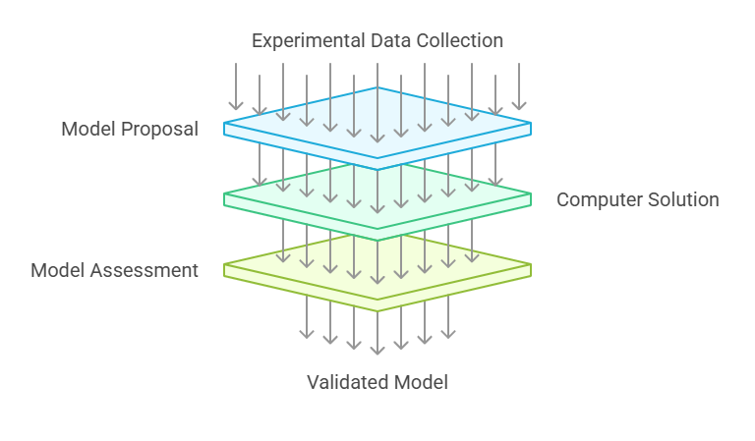
Systems Modelling Process
Fischer, D.S., Villanueva, M.A., Winter, P.S. et al. Adapting systems biology to address the complexity of human disease in the single-cell era. Nat Rev Genet (2025). https://doi.org/10.1038/s41576-025-00821-6

Slide 8
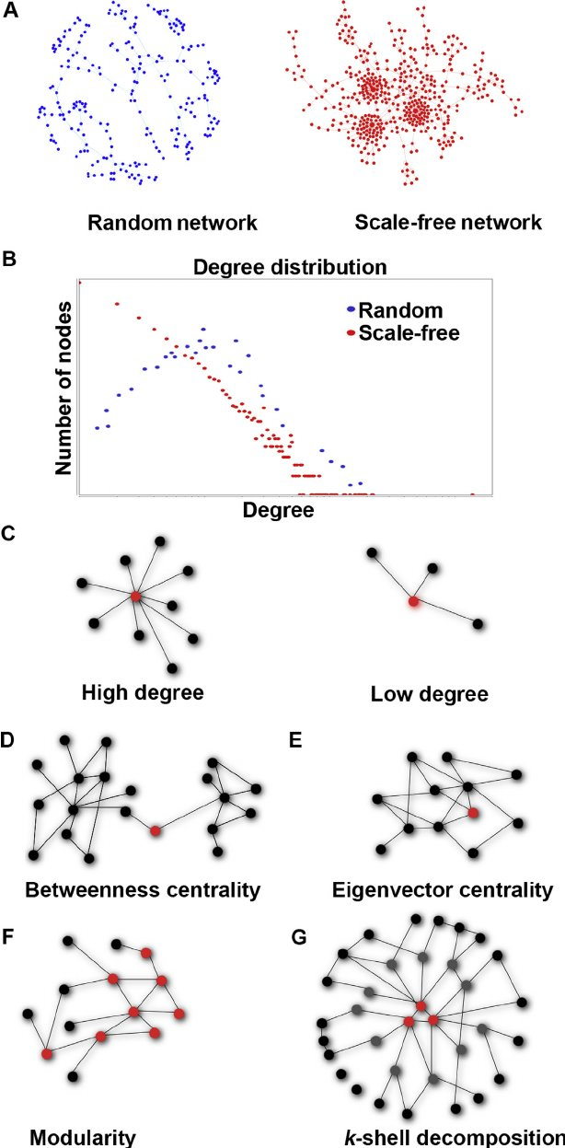
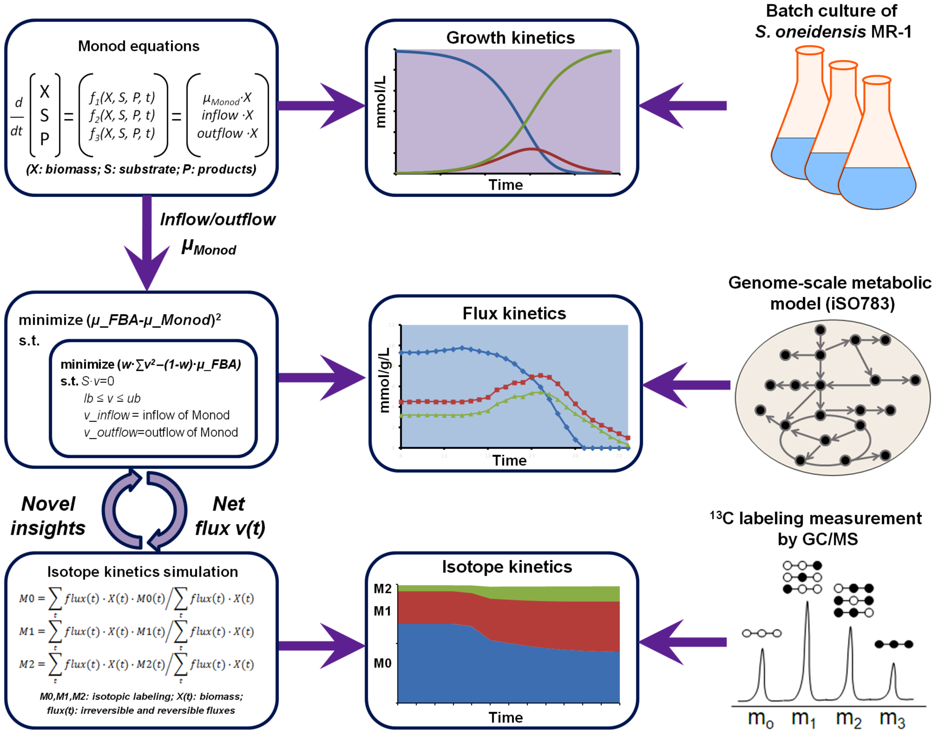
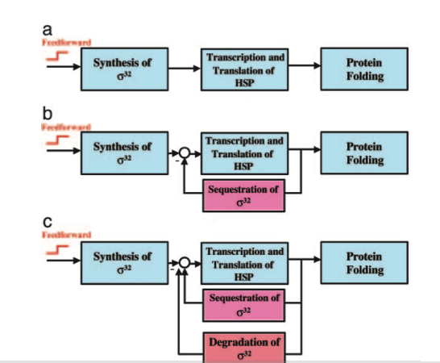
Key levels of systems Biology
Stablity,
Sensitivity
analysis
System Structure
System Dynamics
Topology
of
networks
Systems Biology
Feedback
Mechanisms
Construct,
Modify
Methods
Control Methods
Design Methods
McCormack, M., Lopez, J. A., Crocker, T. H., & Mukhtar, S. (2015). Making the right connections: Network biology and plant immune system dynamics. Current Plant Biology, 5(C), 40–48. https://doi.org/10.1016/j.cpb.2015.10.002
Feng, X., Xu, Y., Chen, Y., & Tang, Y. J. (2012). Integrating flux balance analysis into kinetic models to decipher the dynamic metabolism of Shewanella oneidensis MR-1. PLoS Computational Biology, 8(2), e1002376. https://doi.org/10.1371/journal.pcbi.1002376

Slide 9
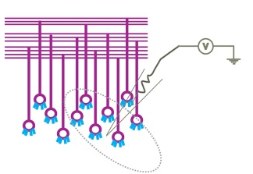
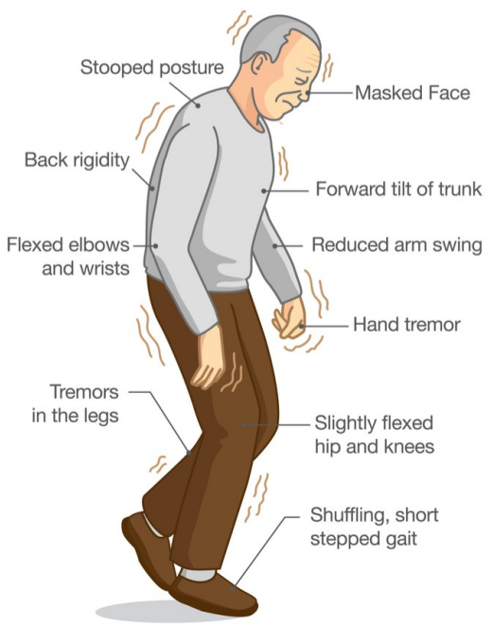
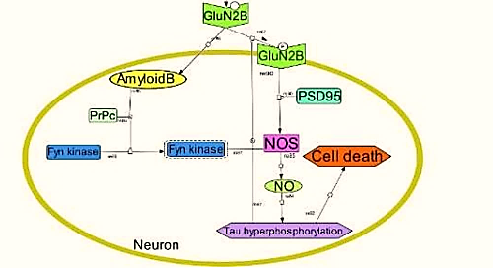
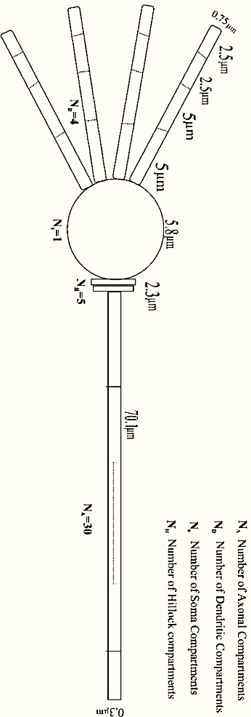
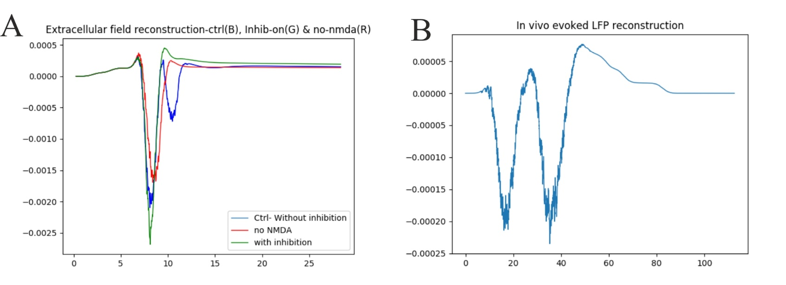
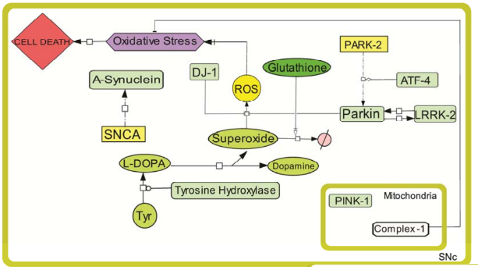

Multiscale Modeling of Biological Systems
Biochemical Pathways
Single neuron model
Population model
Behavioral models

Slide 10
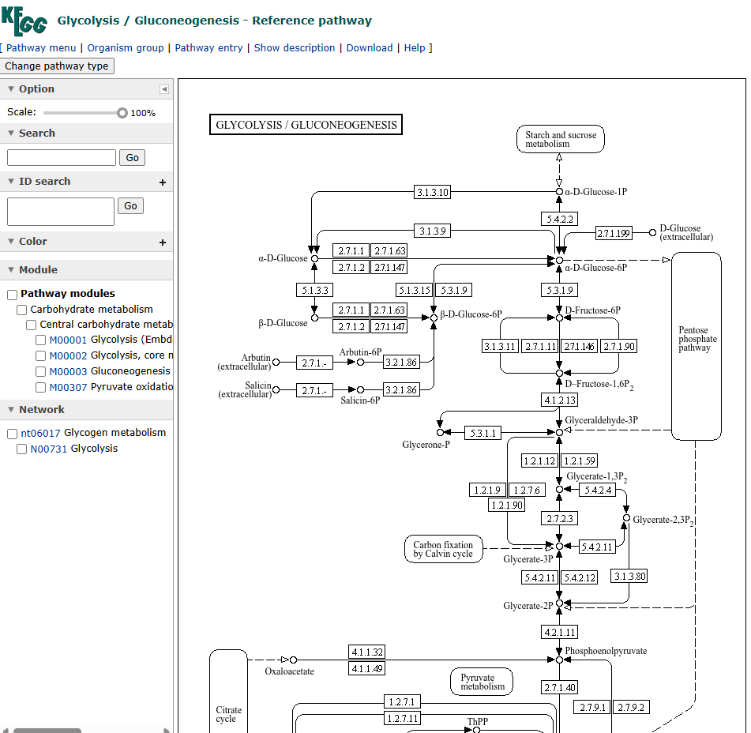
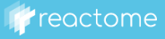



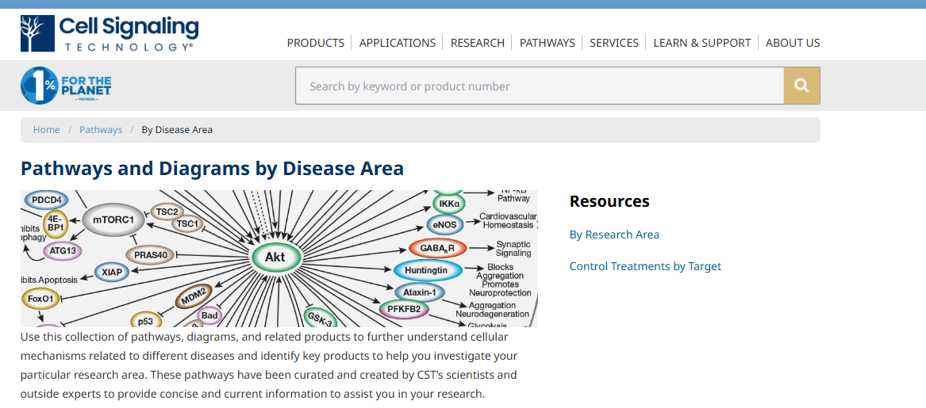
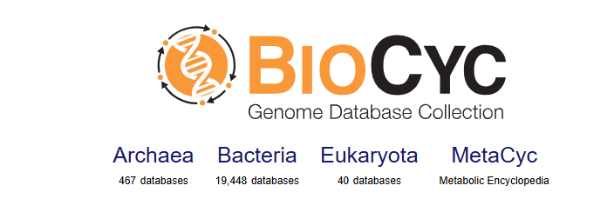
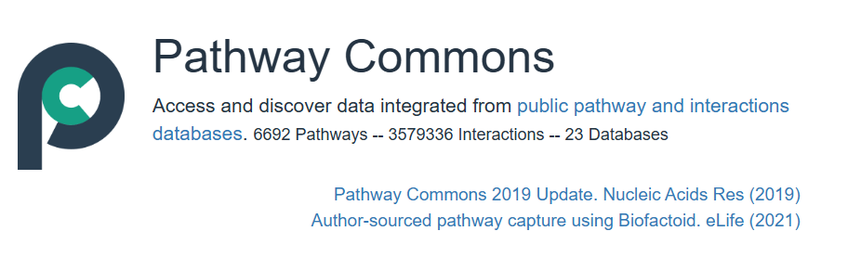
Databases

Slide 11


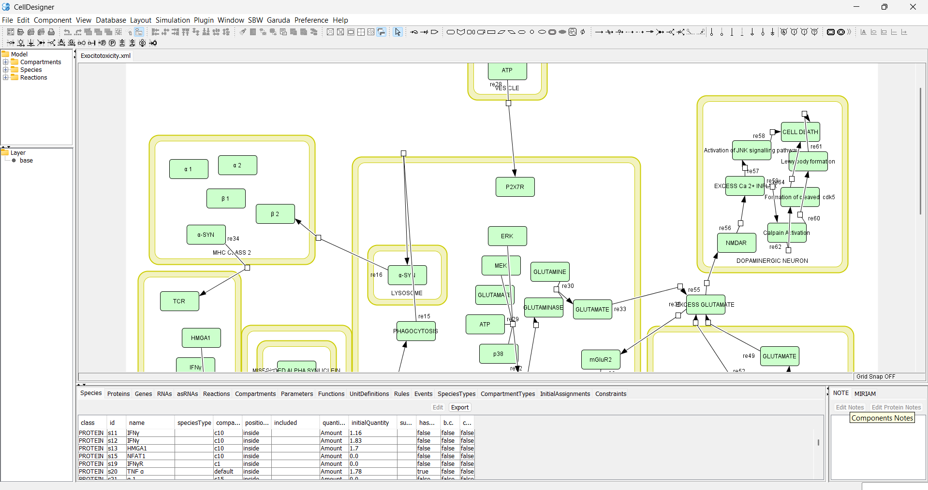
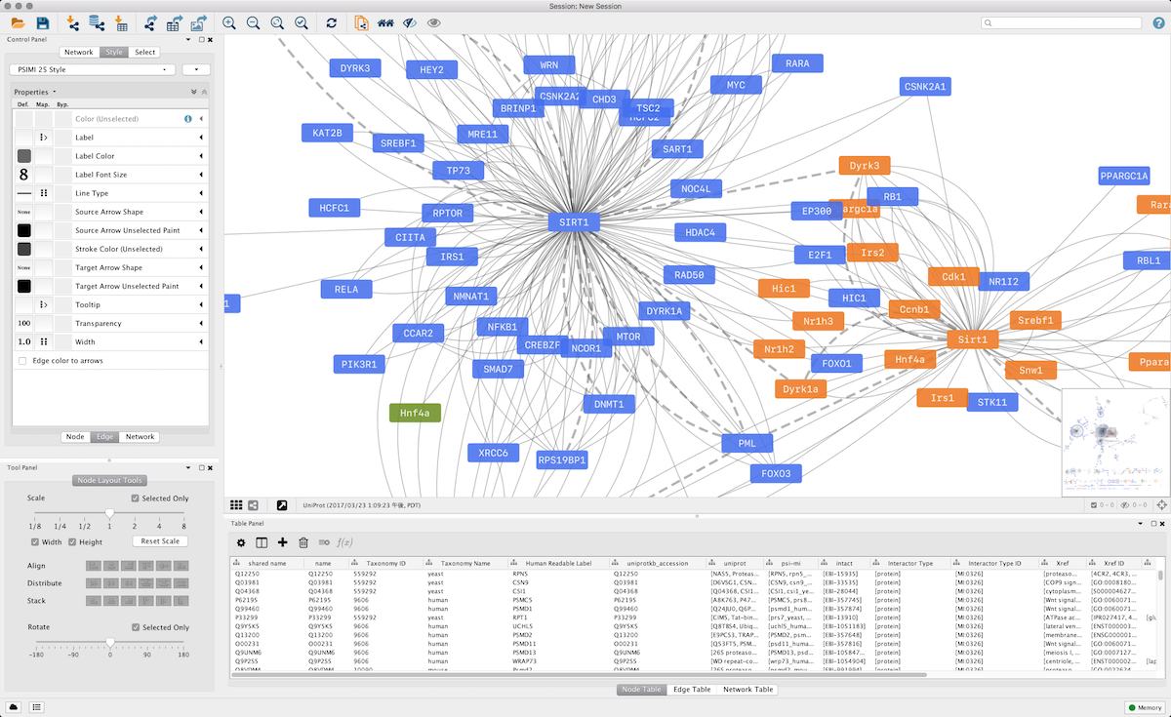
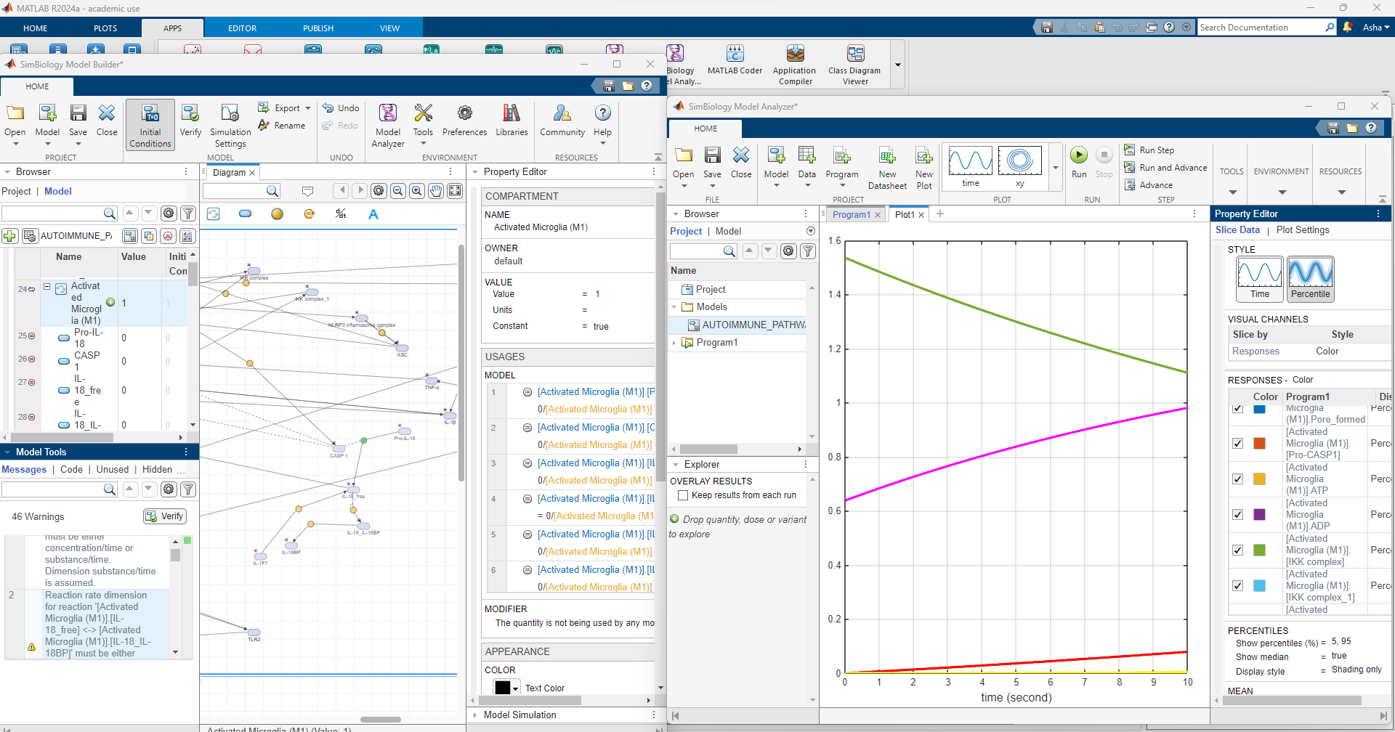
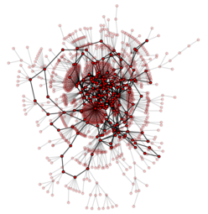


Pathway modeling tools

Slide 12
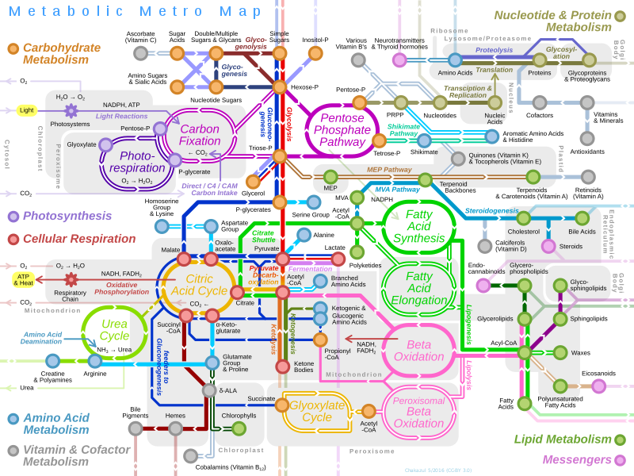
Metabolism
Depends on [S]
Rate of the reaction(k)
Studied at 3 levels..
Enzyme Kinetics
Stoichiometric analysis
Metabolic control analysis

Slide 13
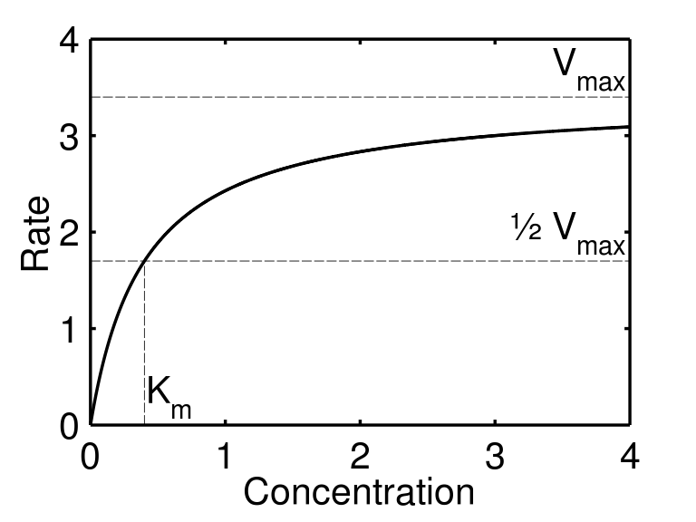
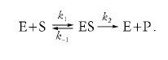
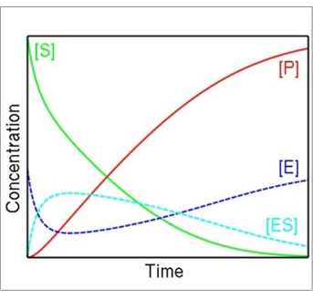
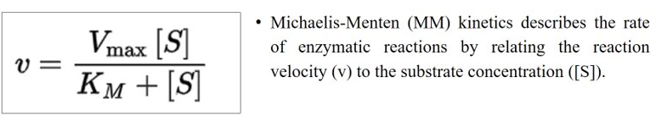
Michaelis-Menten Kinetics
The rate of enzymatic reactions by relating the reaction velocity (v) to the substrate concentration [s]
Assumption
d/dt[ES]~0
E<<<<{S]

Slide 14
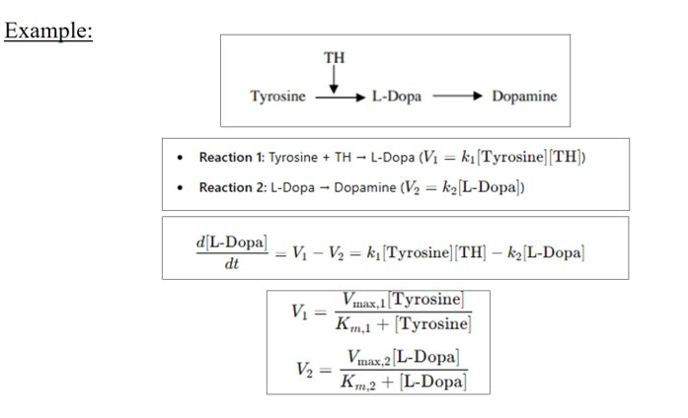
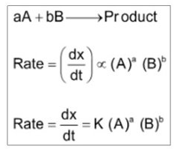
Law of Mass action
Reaction rate is proportional to the probability of a collision of the reactants.
Probability is in turn proportional to the concentration of reactants to the power of the molecularity , i.e., the number in which they enter the specific reaction.

Slide 15
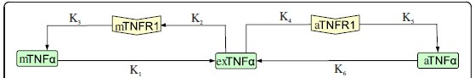
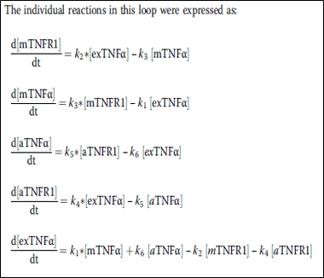
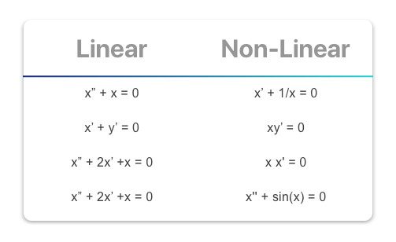
Ordinary Differential Equation
ODE defined for one or more functions of one independent variable and its derivatives
Linear Equation
Non-Linear Equation

Slide 16
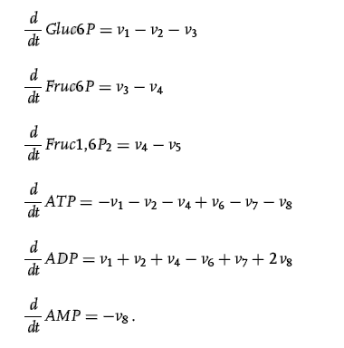
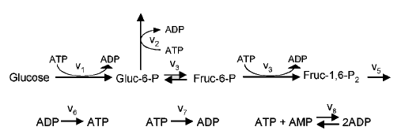
Example: Glycolysis
V₄

Slide 17
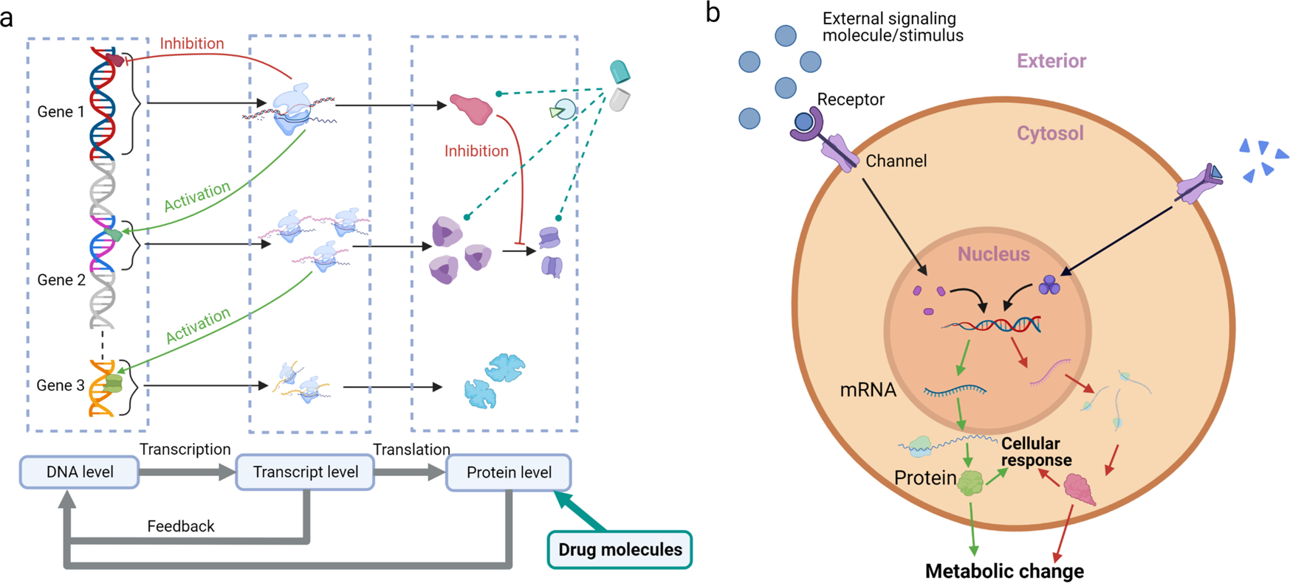
Cell Signalling
Yue, R., Dutta, A. Computational systems biology in disease modeling and control, review and perspectives. npj Syst Biol Appl 8, 37 (2022). https://doi.org/10.1038/s41540-022-00247-4

Slide 18
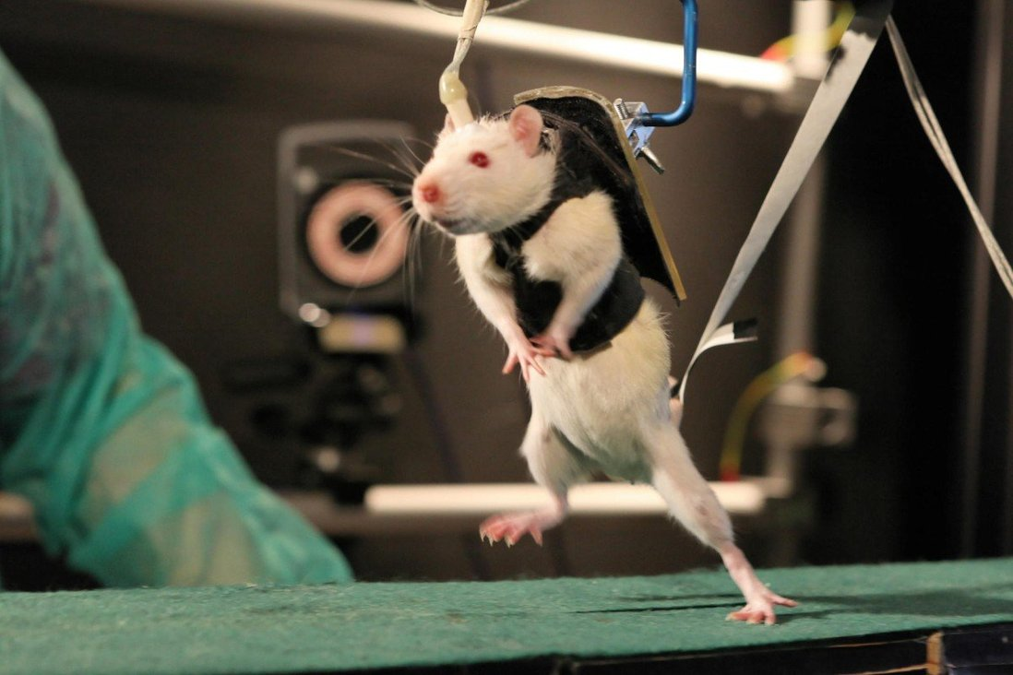
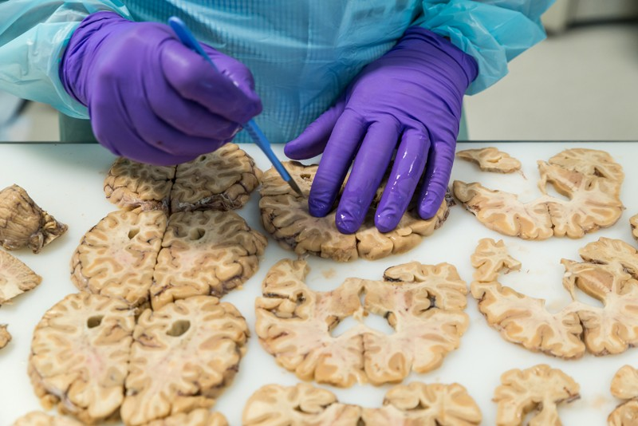
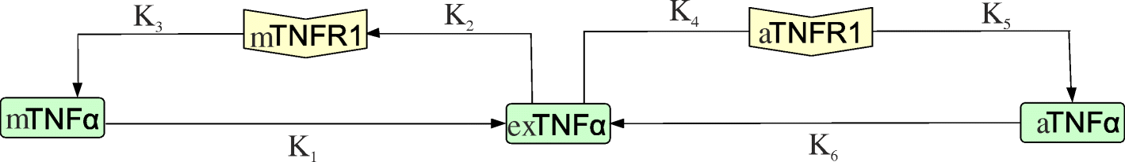
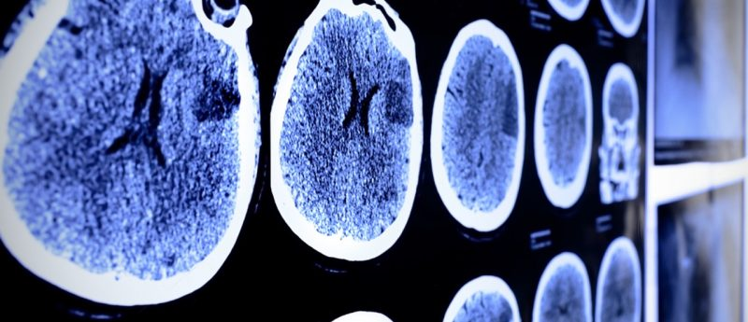
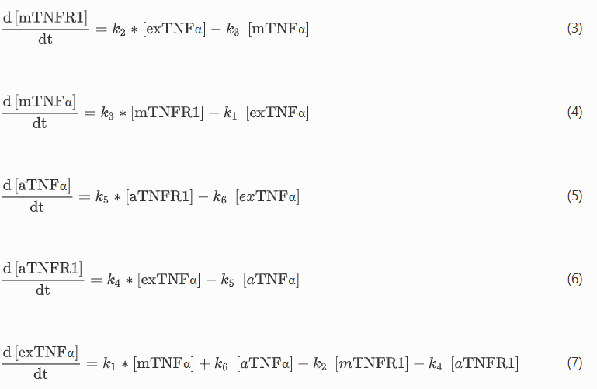
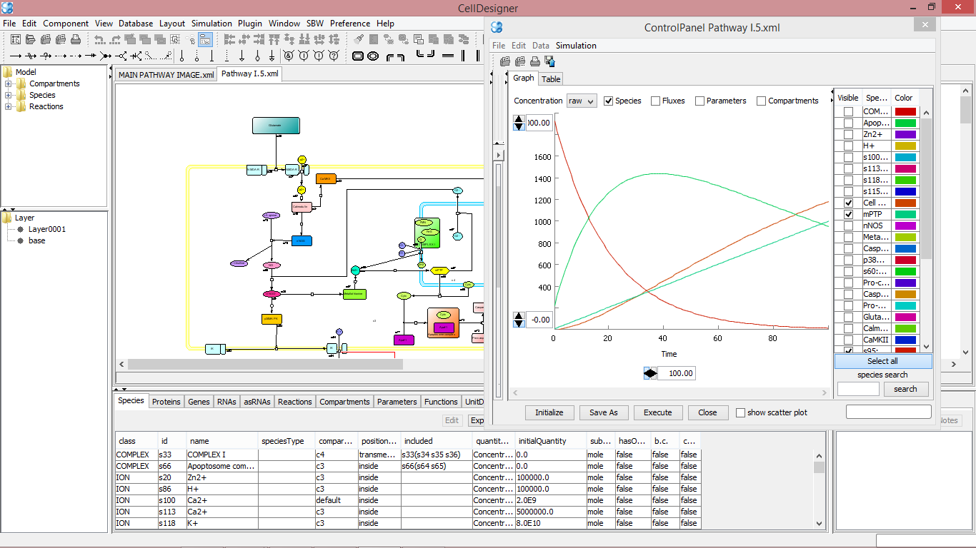
Disease Networks: From Cells to Systems
Prediction model
Diseases/Patterns/Risks
Sasidharakurup H, Diwakar, S. et al. 2020

Slide 19
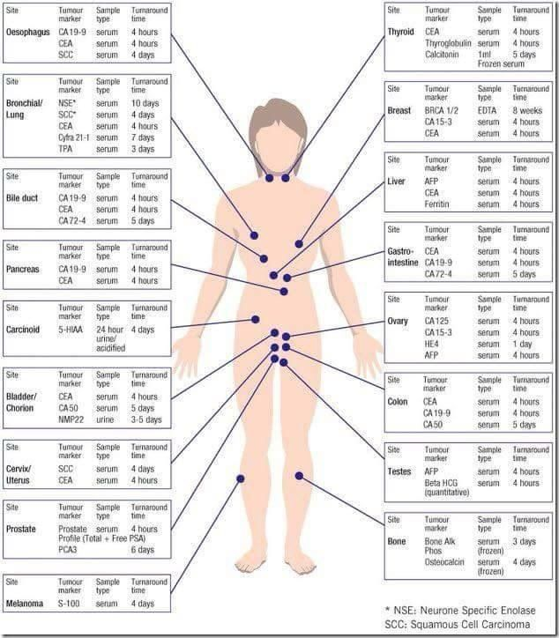
Biomarker Detection
Fischer, D.S., Villanueva, M.A., Winter, P.S. et al. Adapting systems biology to address the complexity of human disease in the single-cell era. Nat Rev Genet (2025). https://doi.org/10.1038/s41576-025-00821-6

Slide 20
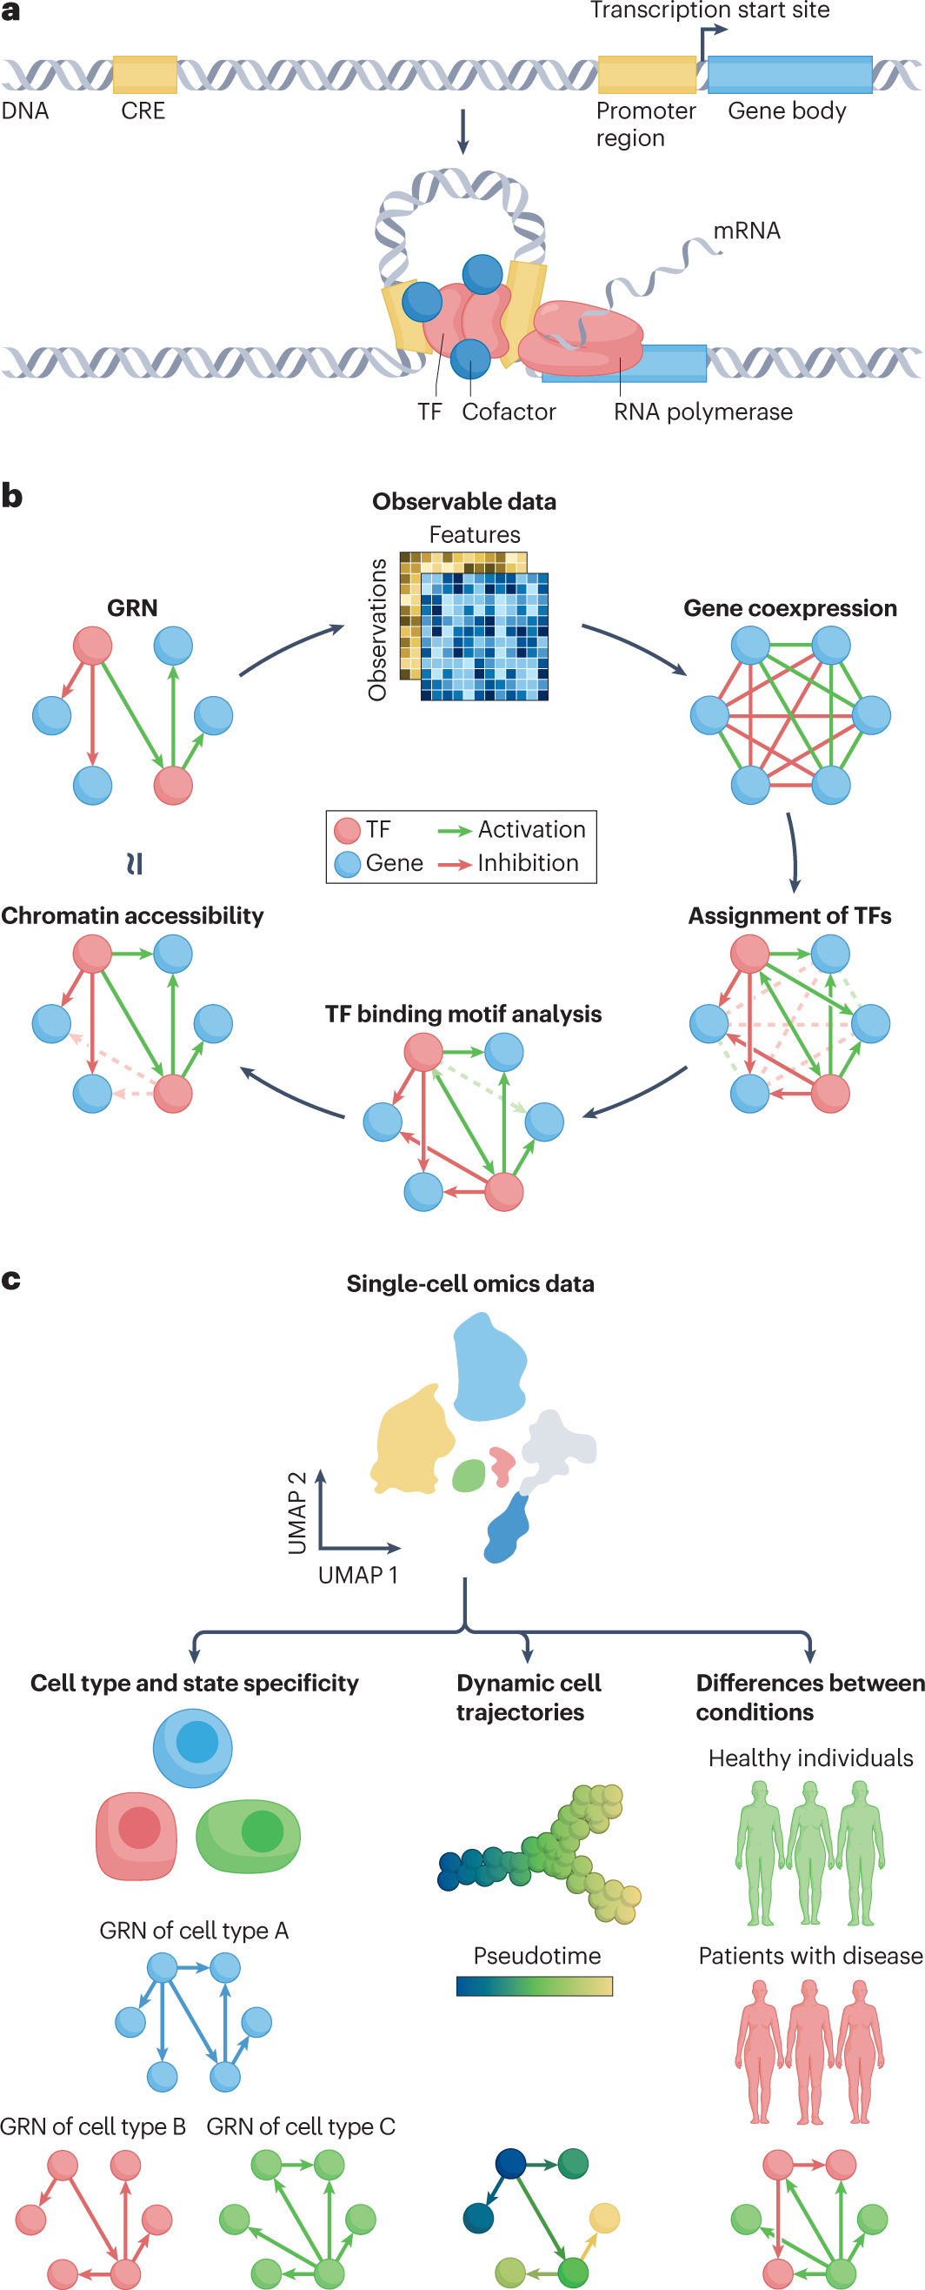
Gene Regulation
Badia-i-Mompel, P., Wessels, L., Müller-Dott, S. et al. Gene regulatory network inference in the era of single-cell multi-omics. Nat Rev Genet 24, 739–754 (2023). https://doi.org/10.1038/s41576-023-00618-5

Slide 21
Gene Regulatory Networks from Omics data
Interpretable computational models of the regulation of gene expression in the form of networks
Badia-i-Mompel, P., Wessels, L., Müller-Dott, S. et al. Gene regulatory network inference in the era of single-cell multi-omics. Nat Rev Genet 24, 739–754 (2023). https://doi.org/10.1038/s41576-023-00618-5

Slide 22
Applications
Badia-i-Mompel, P., Wessels, L., Müller-Dott, S. et al. Gene regulatory network inference in the era of single-cell multi-omics. Nat Rev Genet 24, 739–754 (2023). https://doi.org/10.1038/s41576-023-00618-5

Slide 23
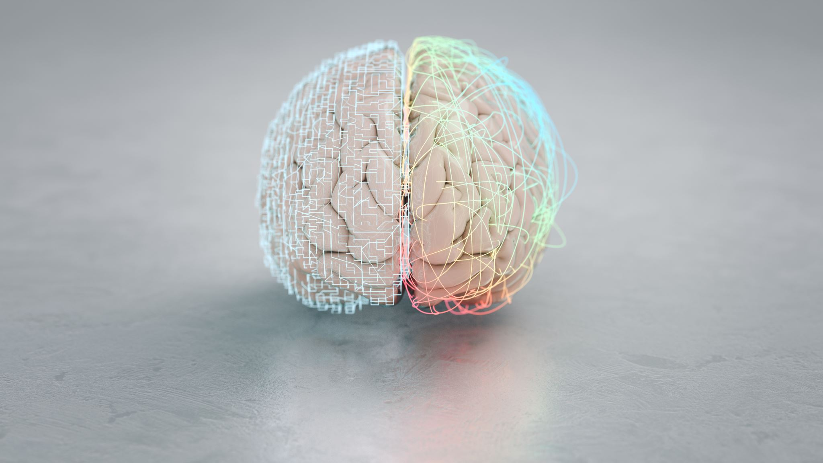
@

Slide 24
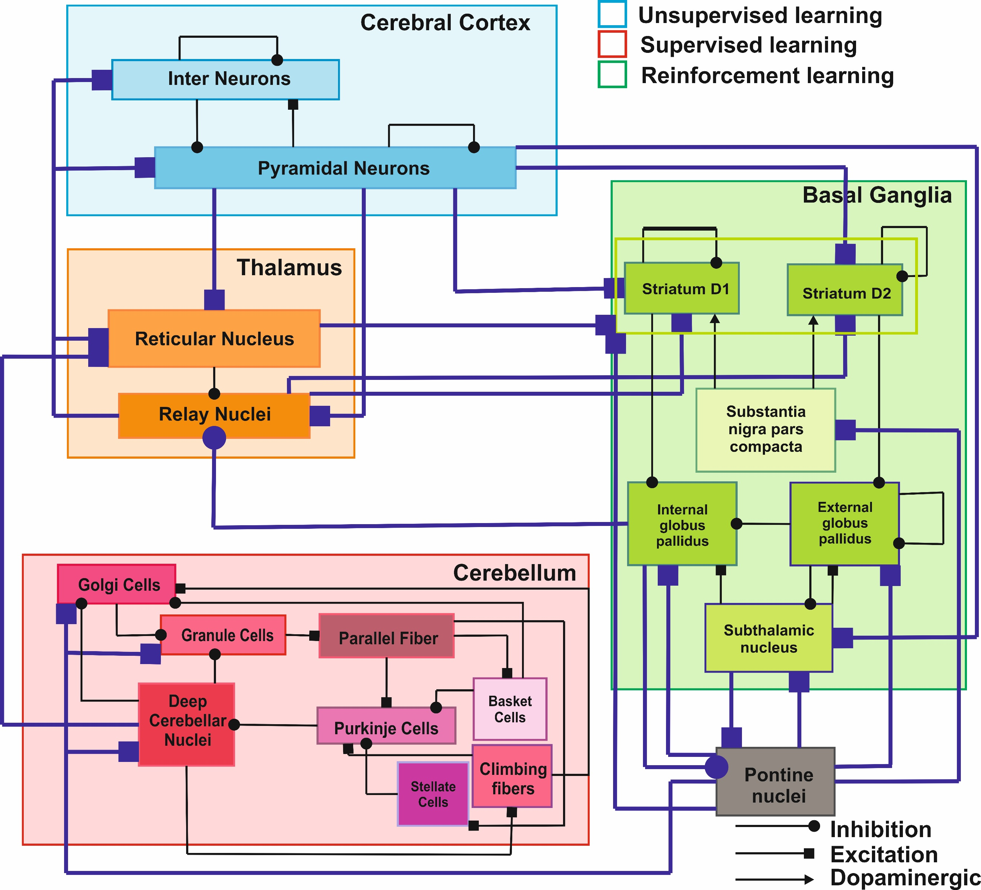
Computational Neuroscience Research
Disease Networks: From Cells to Systems
Interconnected Motor Systems in Brain
Reconstructing Local Field Potential from realistic computational models for spontaneous and evoked stimuli
Sasidharakurup H, Diwakar, S. et al. 2017-2021
Rajendran A., Diwakar, S. et al. 2016- 2021
Parasuram H., Bodda S Diwakar, S. 2016

Slide 25
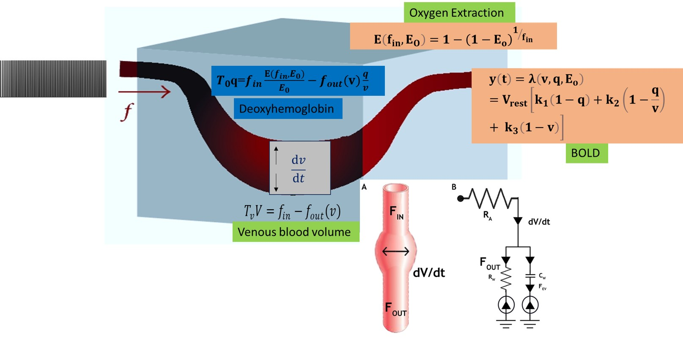
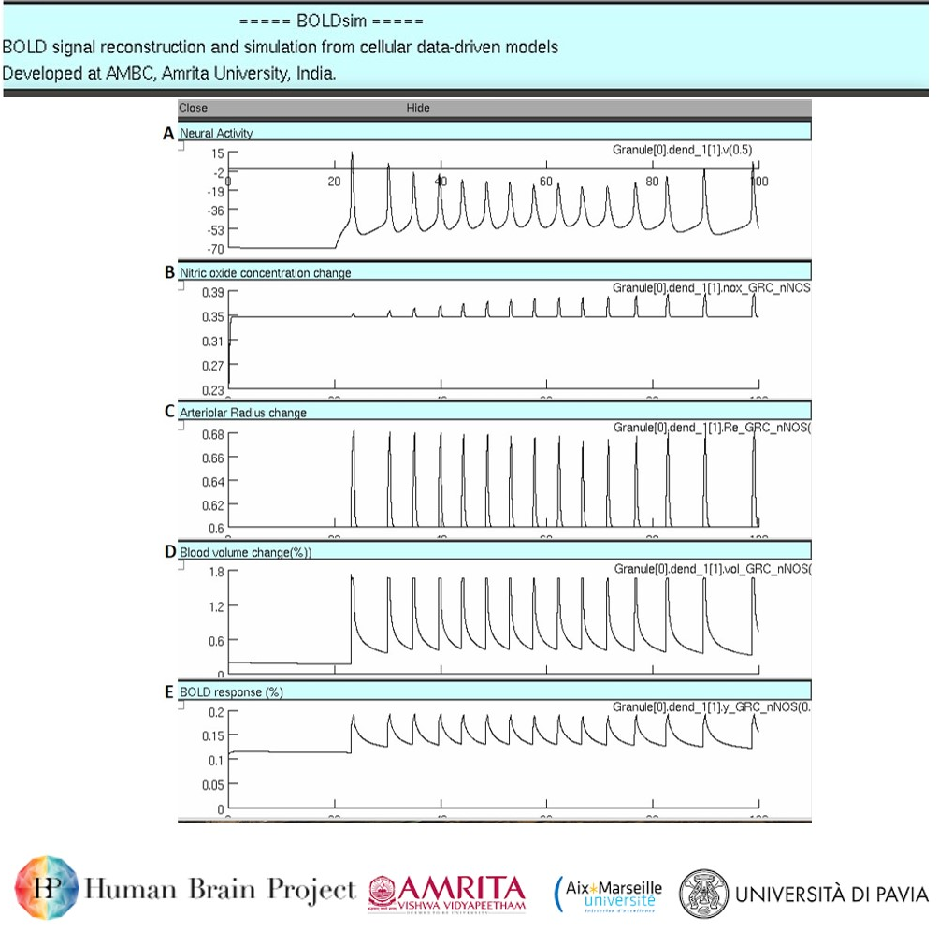
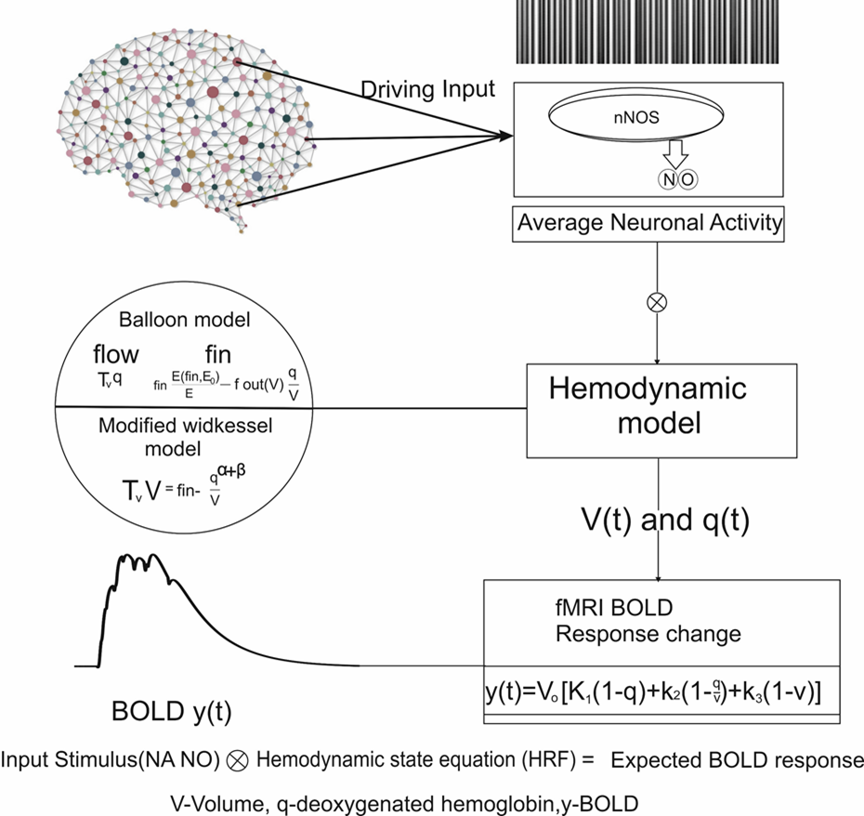

Computational Neuroscience Research
Computational Modeling of Neuro Vascular Coupling
Computational Modeling of fMRI BOLD responses from Neural Circuits
Radhakrishnan S. et al. 2019, 2020
Nutakki C. et al. 2016,2019

Slide 26







Brain-Computer Interfaces & Biomedical Devices
Cerebellum inspired spiking neural network for robotic abstraction
Experimental recording and assessment of human gait Using Mobile Phone Sensors and EEG
Biomechanical
Data Extraction
Nutakki C, Balachandran A, Diwakar, S. 2018-23
Vijayan &Diwakar, 2022
Left Hip
Left Ankle
Low cost device development
Left knee
Right knee
Right Hip
Right Ankle

Slide 27




Brain Computer Interface and Assistive Technology Using EEG
Yogic Visual Concentration (Trātaka) Assessment
Grasped movement and Analysis using EEG
Understanding Music Ragas
Yoga and Meditation research
Sandeep et al. 2017,2022

Slide 28







Education, Augmented reality and Virtual labs
Augmented Reality
Model of virtual labs in education

Slide 29



Society and Health
Diversity Studies – Surveys: Social and Neuropsychological assessments
Life Style and Health
Lifestyle Markers, Daily Life and Health Conditions
Using surveys and apps for data collection, analysis and assessment
Diwakar, S., (2023). Diversity and neocolonialism in Big Data research: Avoiding extractivism while struggling with paternalism.
Nutakki, C., Diwakar, S., (2023). Generalization and Personalization of Mobile Sensing-Based Mood Inference Models.

Slide 30

Thank You

